Slide 1

Optimizing Hotel Booking Retention: Data Insights

Slide 2
AGENDA OVERVIEW
Project Recap : We’ll start with a brief overview of the project, highlighting the key objectives and the scope of our analysis.
Problem : Next, we’ll delve into the core issue at hand—the increasing rate of hotel booking cancellations and the impact it has on business performance.
The Analytics Team : We'll introduce the team behind the analysis, including our roles and contributions.
Process : We will then walk through the steps we took to analyze the data, including data collection, processing, and the methodologies employed to derive insights.
Insights : We'll present the key findings from our analysis, focusing on the trends, patterns, and factors influencing booking cancellations.
Summary : Finally, we'll conclude with a summary of our findings and recommendations on how to address the identified issues and improve customer retention.

Slide 3


PROJECT RECAP
1. The project focused on analyzing hotel booking cancellations.
2. Objectives included identifying key reasons for cancellations, trends over time, and suggesting strategies to reduce cancellations.
3. Tools used: Excel for data analysis and dashboard creation.

Slide 4


Analyze cancellation rates by month to identify seasonal patterns and high-risk periods for bookings
Compare reserved room types vs. assigned room types to determine if mismatches contribute to cancellations
Examine cancellation rates across different guest types (couples, families, singles) to identify high-risk segments
Calculate and compare cancellation percentages for each hotel to determine which property experiences more frequent cancellations
PROBLEMS

Slide 5



THE ANALYTICS TEAM
ANDREW FLEMING
(Chief Technical Architect)
MARCUS ROMPTON
(Senior Principle)
ANMOL KAPOOR
(Data Analyst)

Slide 6





PROCESS
UNDERSTANDING DATA
DATA CLEANING
DATA MODELING
UNCOVER INSIGHTS

Slide 7
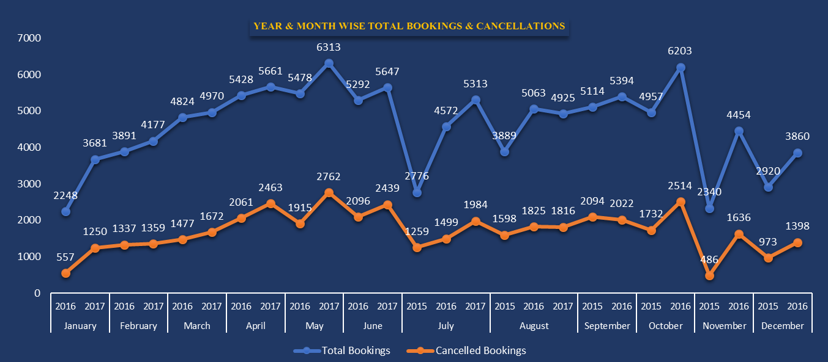
INSIGHTS
1

Slide 8
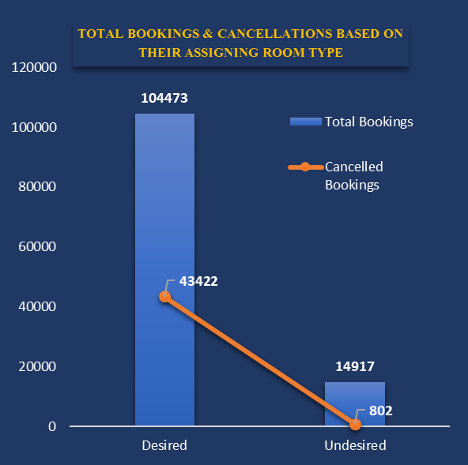
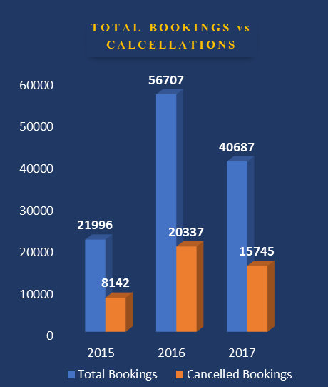
INSIGHTS
2

Slide 9
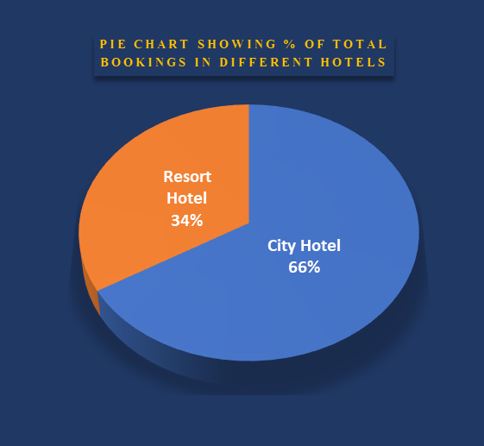
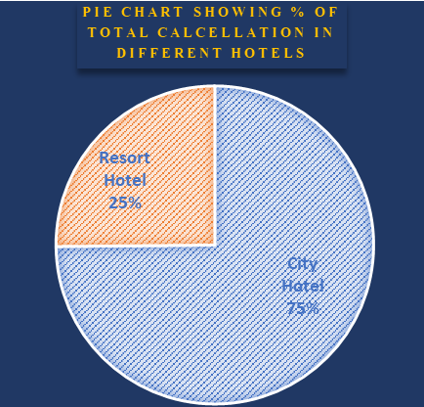
INSIGHTS
3

Slide 10
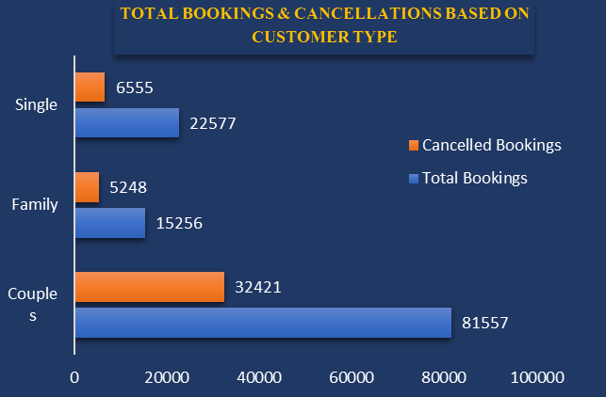
INSIGHTS
4

Slide 11
SUMMARY
The data indicates a significant number of cancellations, with certain months showing higher rates, potentially linked to seasonal trends or specific guest types.
A notable pattern is observed in cancellations when there is a mismatch between the reserved and assigned rooms, indicating that guest dissatisfaction with room allocation could be a factor.
Certain times of the year (such as off-peak seasons) show a spike in cancellations, indicating that special promotions or flexible booking options might be required during these periods.
Focus on improving the accuracy of room assignments, tailoring communication and offers for high-risk guest segments, and enhancing flexibility during off-peak seasons to reduce cancellations.

Slide 12
THANK YOU
BY:ANMOL KAPOOR

